Slide 1
Unique Corns
Parth, Allen, Clare,
Jenny, Pascal, Patrick

Slide 2
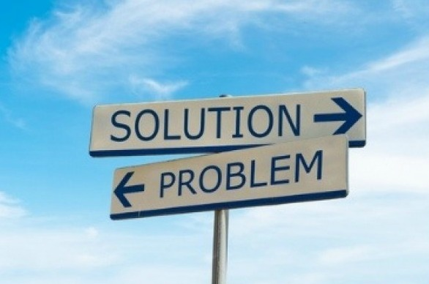
Refresher
When I have a busy schedule and school work, I want to look for social events that fit into my schedule, so I can still have a balance between social life and academic life.
When I cannot find social events that fit my interests, I want to look on social media to see what events my friends are interested in, so I know what events are available and which friends I can go to the events with.
When I have anxiety attending social events by myself, I want to know which friends are attending certain events, so I can ask them to attend with me. So I will be more comfortable at the event.
When I know I have assignments and midterms coming up, I want to know what events are available far in advance and finish my work early, so I do not have to stress when I attend the social event.
When I am looking to make friends at school and join more social events, I want to look into becoming a member of a student club that I am interested in. So I can follow up on the events hosted by that club and meet people that have the same interest as me.

Slide 3
Initial Ideas
Brainstorming

Slide 4
Social Media Extension
Mobile/Web Application
On Campus Events
Quercus
Communal Board
Friends
Time Management
Social Media
Scheduling
Academic Life
Workload
Interests
Social Life
School Clubs
STUDENTS

Slide 5
Sketches

Slide 6
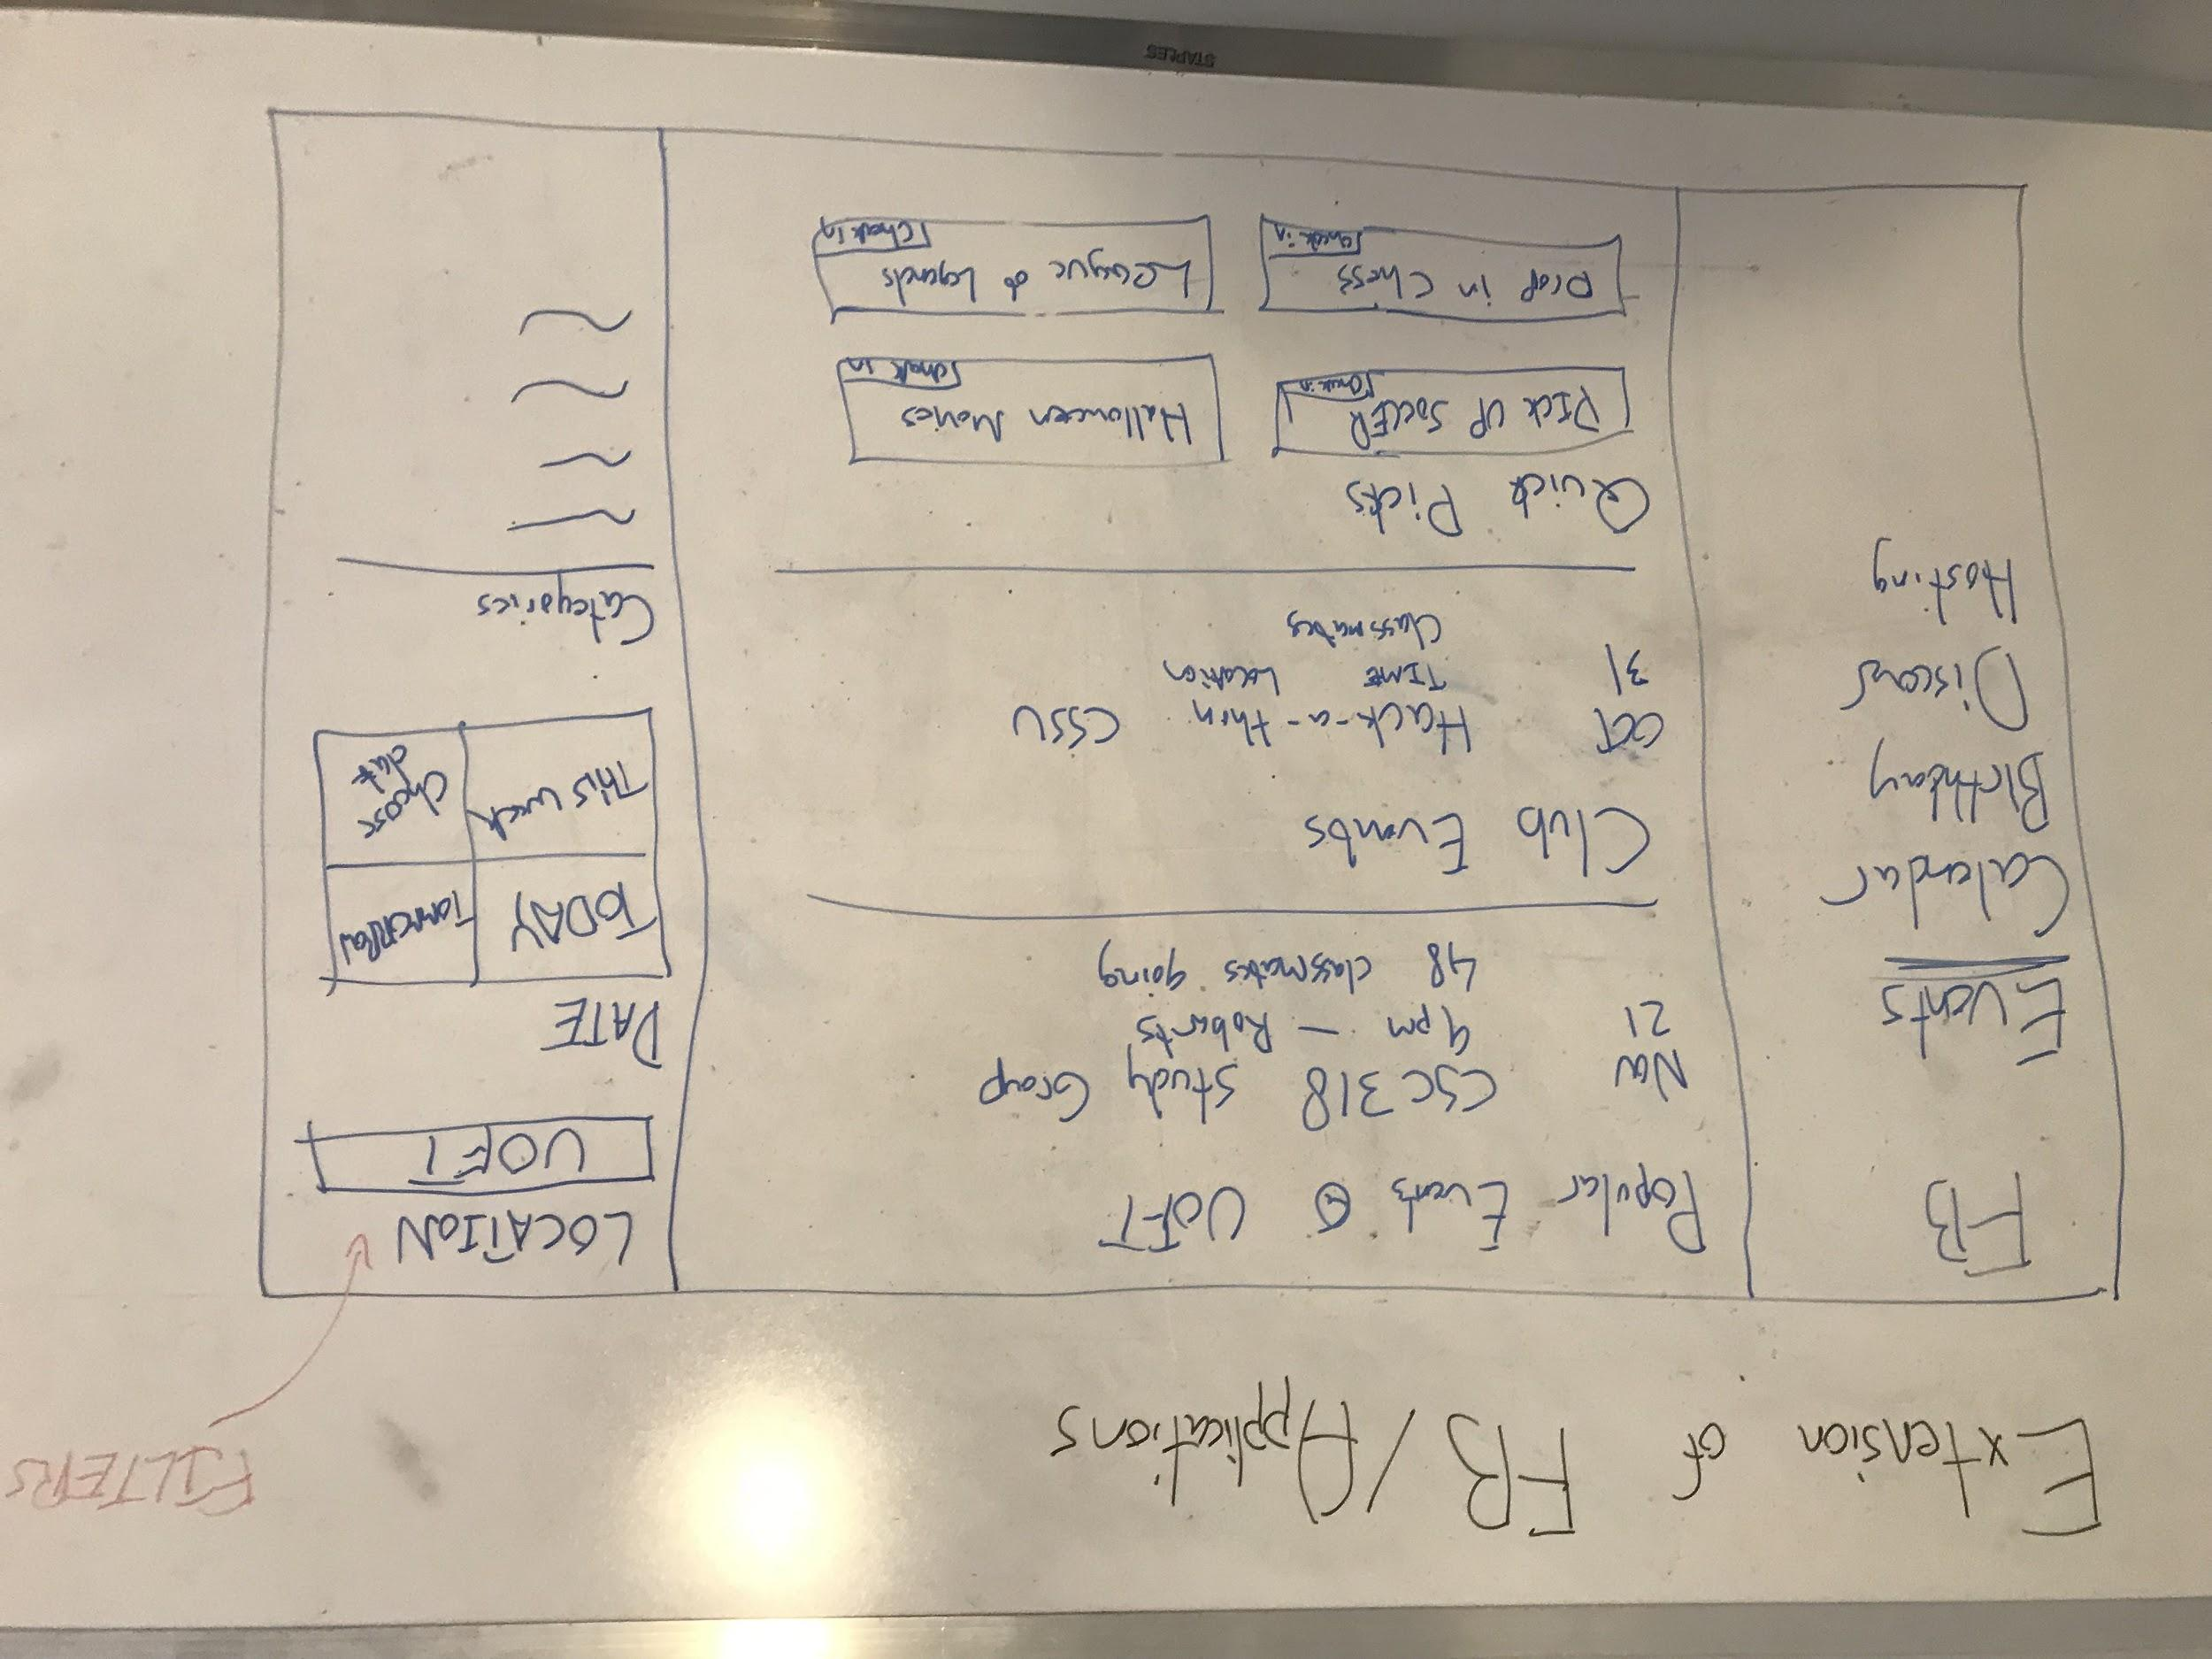
Extension of Pre Existing applications
Takeaways
Extending from social media, Facebook Events, showing the facebook events in an organized manner, based on location, time, and category, make it easier to navigate through school events.
Social media is a convenient tool for students to look for events
Events can be clearly laid out, can see which friends are going
Might have existing functionality, adding features will make it look too busy

Slide 7
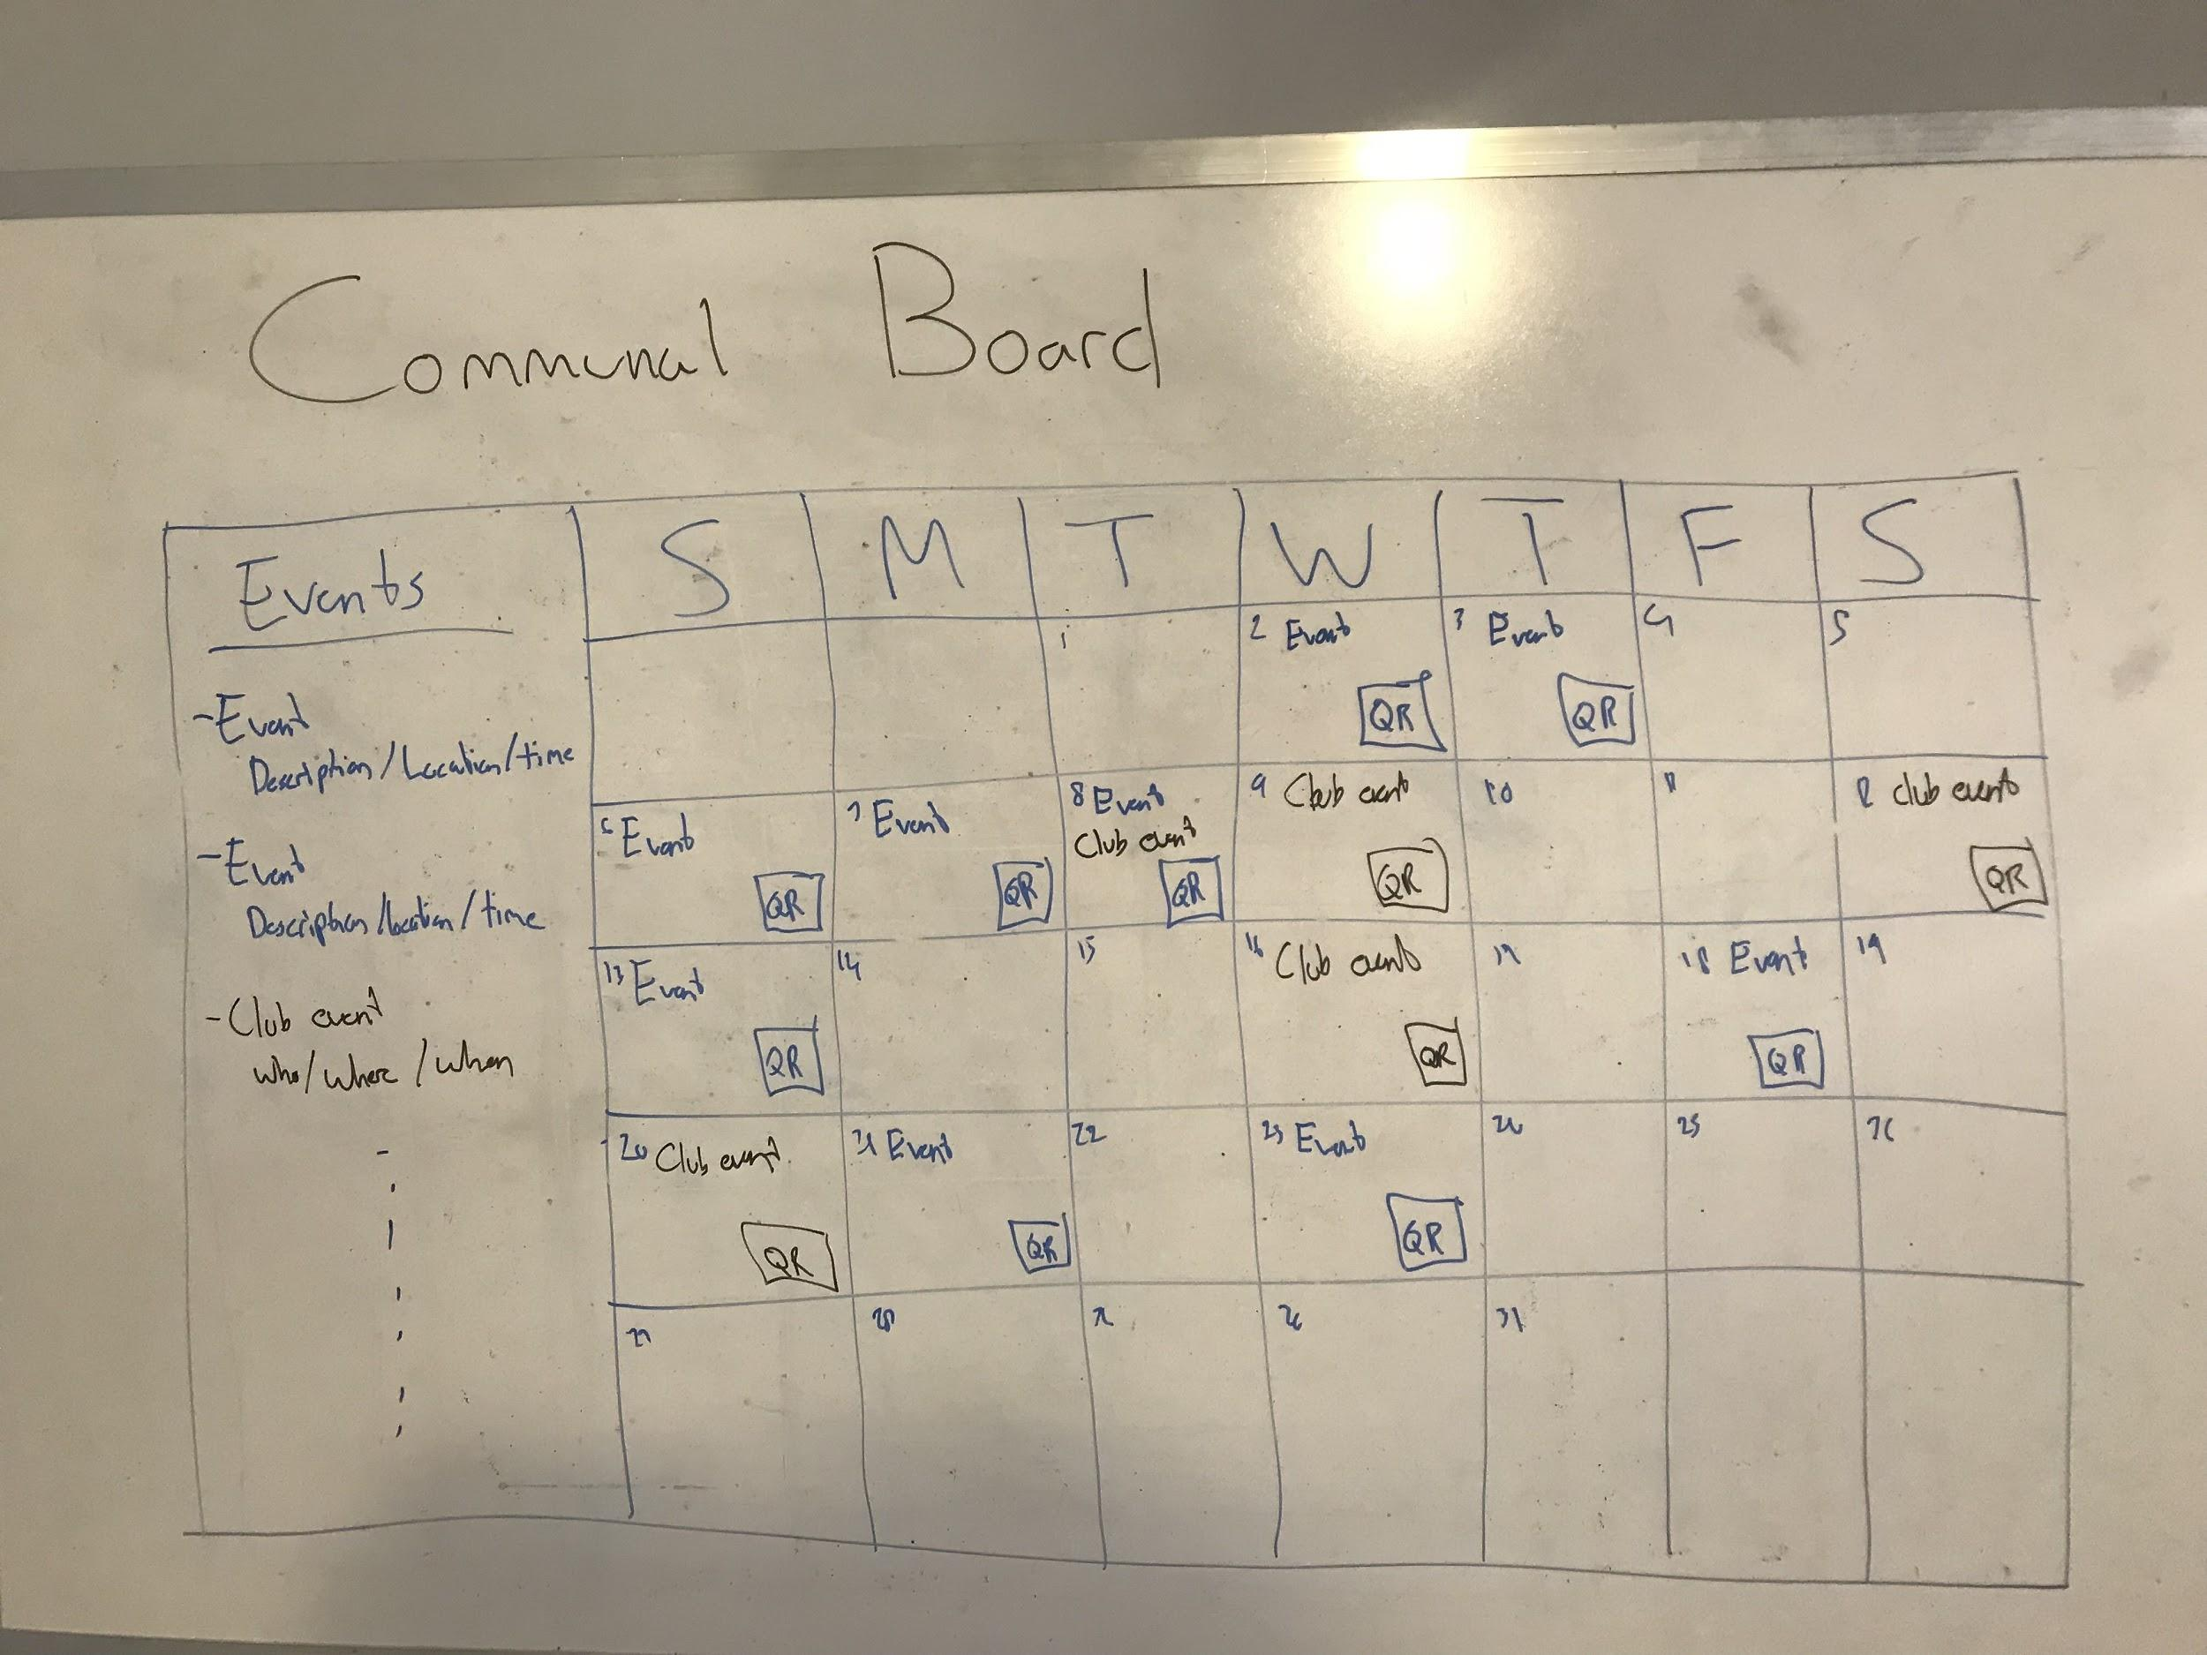
Student Hub - Communal Board
Takeaways
A communal board, where all events that are of interest/ available are shown clearly on a calendar based on a certain algorithm:
Opened to having a variety of events for people who are looking for different types of events
Can see multiple events at once
Calendar good for time managing and scheduling
Traditional, not as widespread as social media
Can become spammed/ crowded
Hard to find

Slide 8
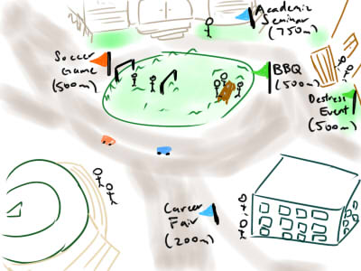
Designated Event Zones around Campus
Takeaways
Map showing what events are happening throughout campus, can alert students about which events are currently going on:
Map feature is a good implementation for the final product
Nice to sort out events by type and location, good to visualize where events are
Real-time event alerts can be helpful for students who happen to be in the area
People might still miss the event if they are not in the event zone
Will be bias towards certain hobbies/events

Slide 9
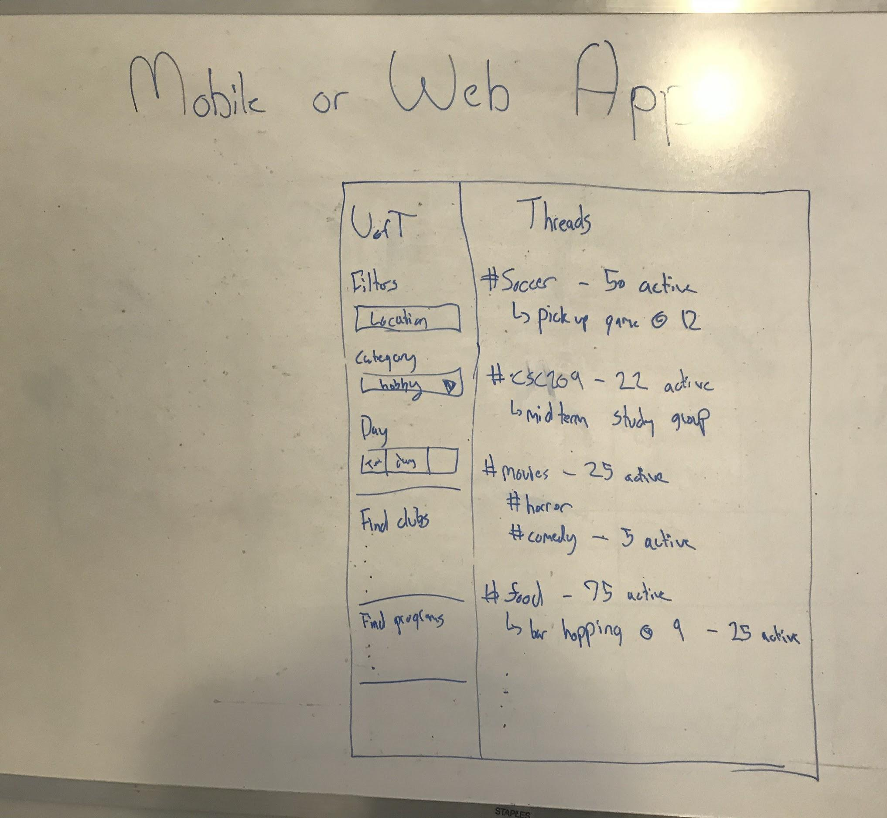
Mobile or Web Application
Takeaways
Have an application specifically for finding events, and sorting the available events, the application can also see what events your friends are participating in:
More design freedom
Accessible, can be pulled out anywhere
Much easier to design an interface tailored for our problem
Need to get people on the app
More groundwork required than extending something else

Slide 10
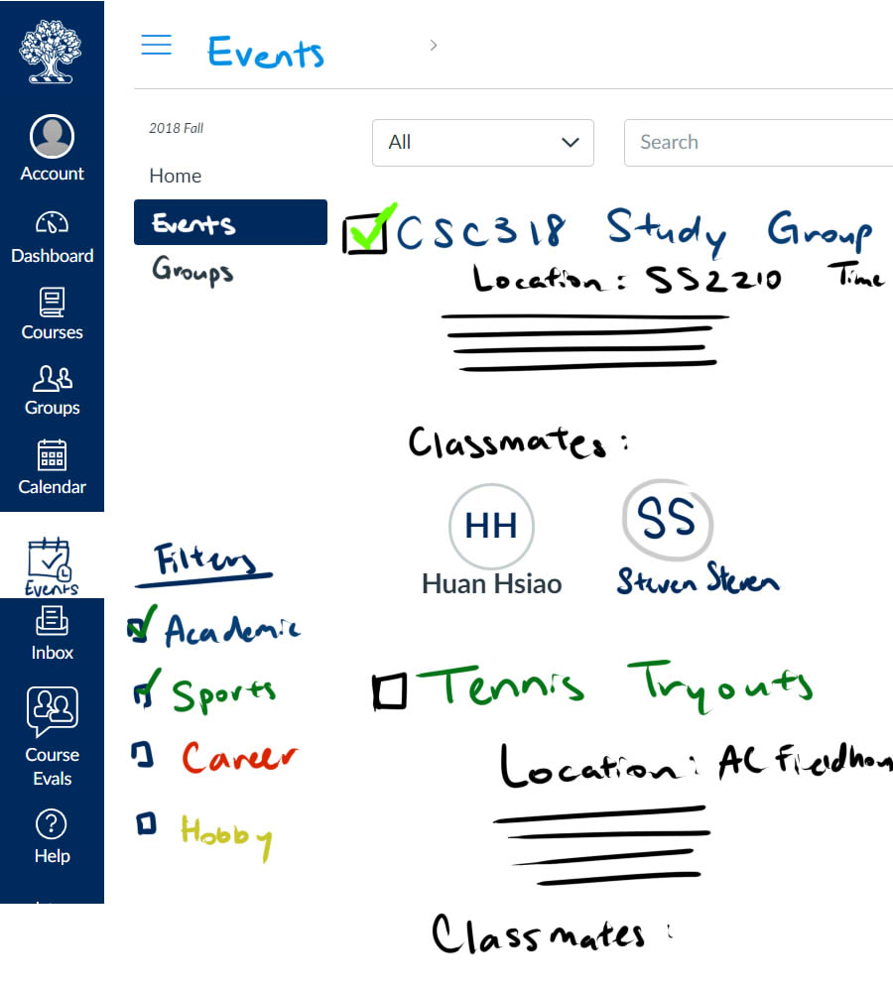
Quercus Implementation
Takeaways
Extending from Quercus, show events based on your courses, your faculties, can filter out different types of events, shows what events your classmates are attending:
Able to access school information: schedules, classes, faculty
All students have access to Quercus
Already a built-in calendar function, announcements
Quercus already has a set design, not much design freedom

Slide 11
Top 3 Concepts
Pros and Cons

Slide 12



Concept | Pros | Cons
Communal Board | Centralized place where all the information can be Allow for communication within the student community | Have to make sure that students check the board Might be harder to find people of similar interests Risk of spam or too much information posted
Mobile or Web Application | More flexibility, can add in specific features Specifically focus on our problem without adding too many extra functionalities The interface can be unique, tailored to our problem statement | Not everyone will have the app More work to create something from scratch compared to extending off of existing solutions
Quercus Extension Implementation | Every student uses Quercus Students focussed on academics will be able to find events through Quercus Can access student’s classes and schedule information | Might be too distracting since Quercus already have many features Limited design if extending from Quercus

Slide 13
Refined Solution

Slide 14
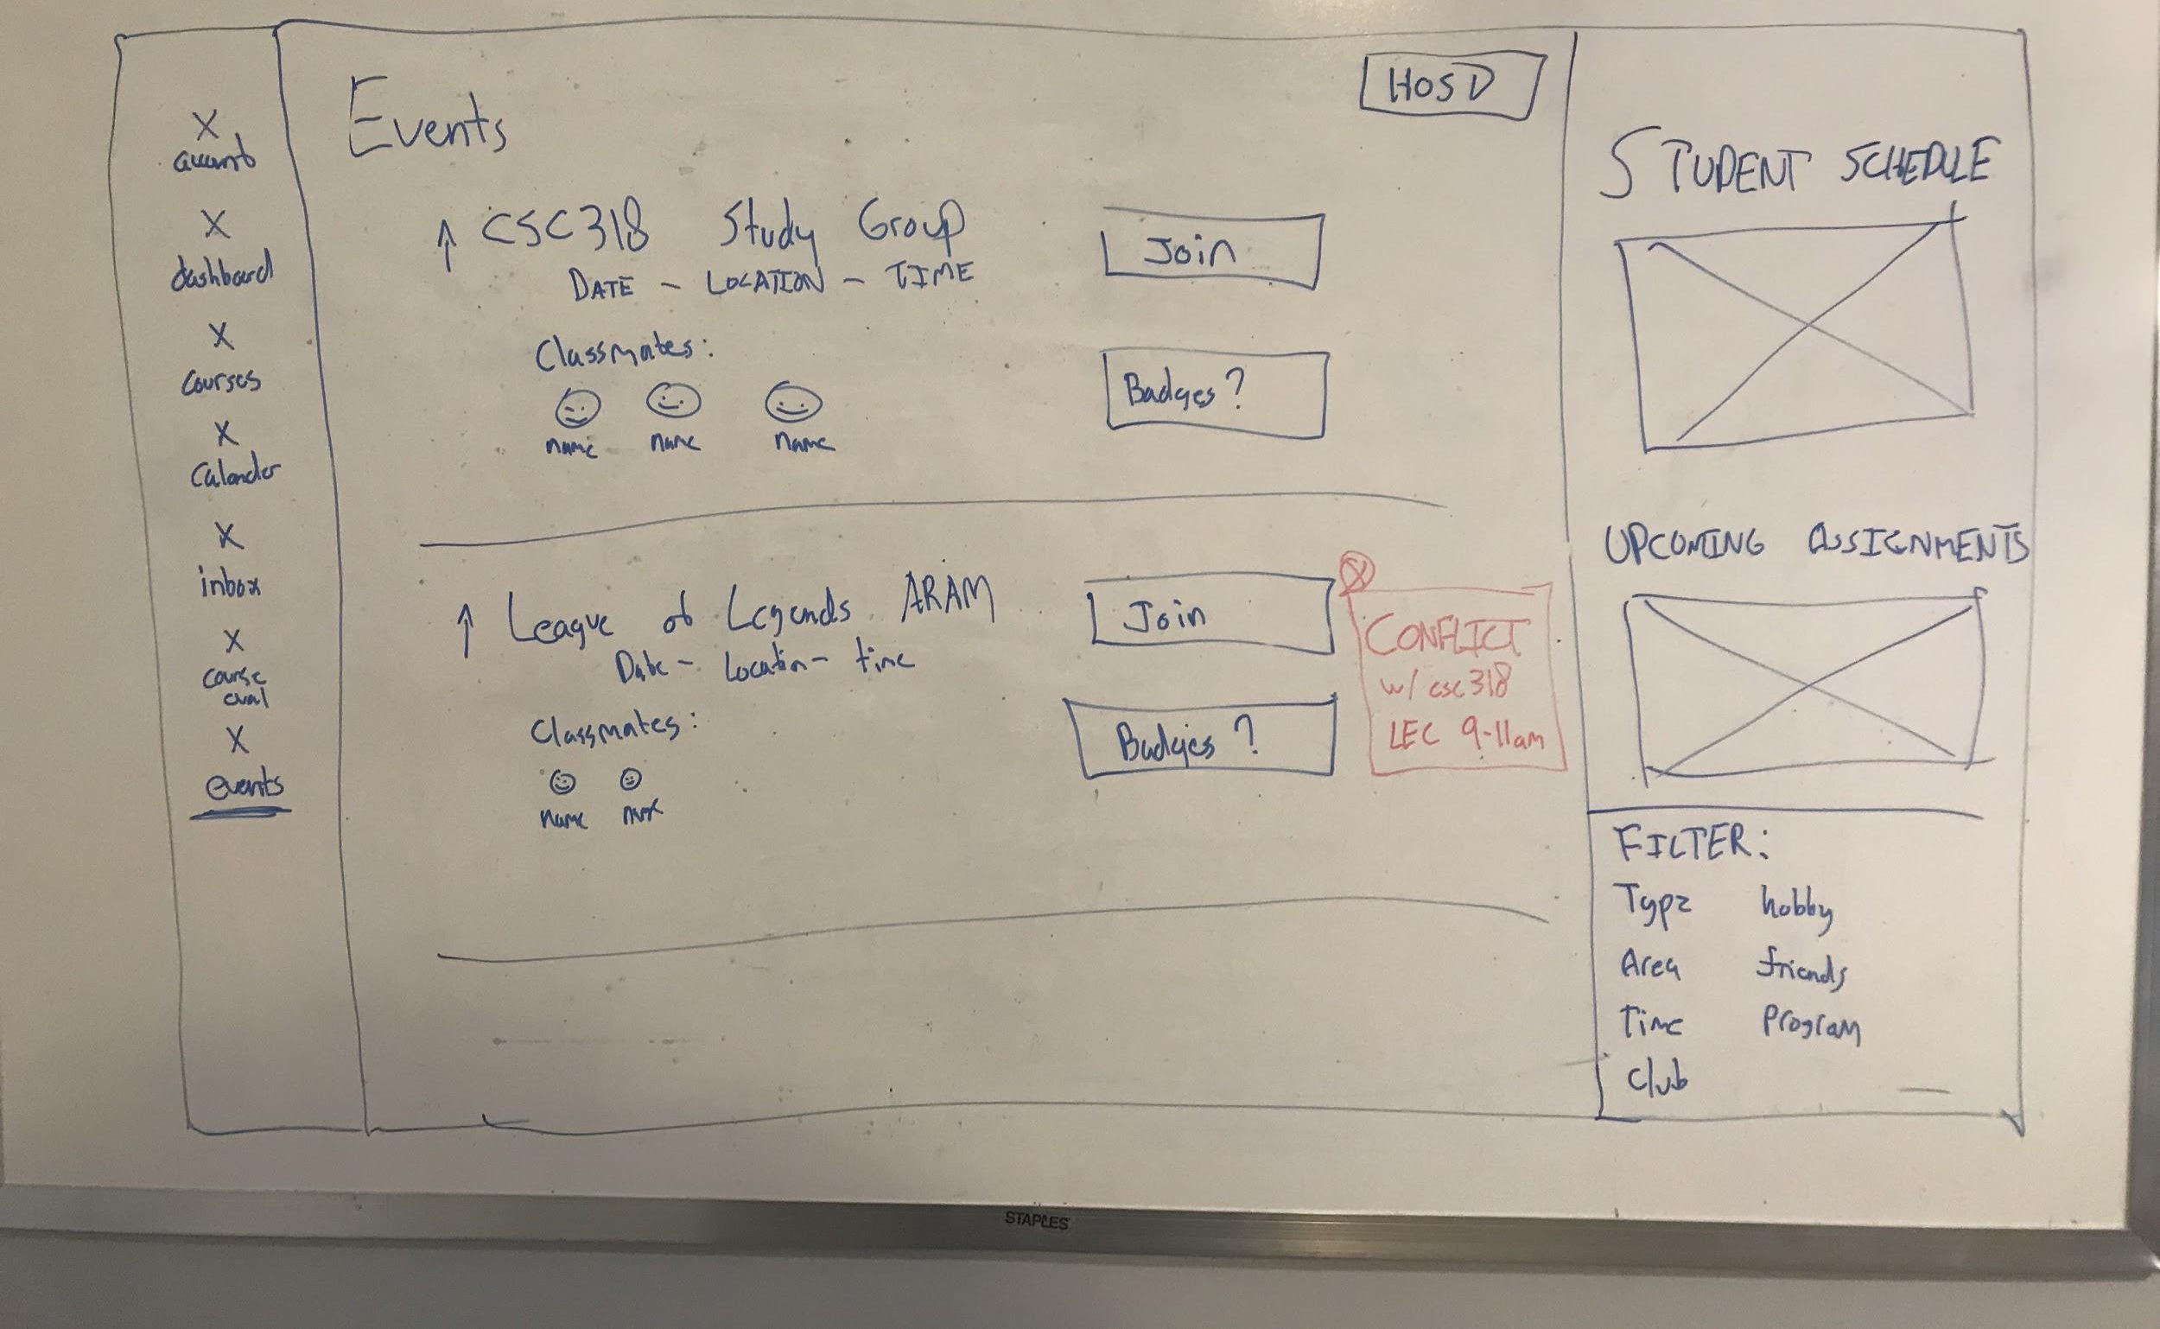
Bringing all ideas together
Web/Mobile app
Takeaways
Connecting a student’s time schedule and bringing all events across all different platforms into one location
Reward System
Badge System (Prof Ashton Anderson from cs dept.)
Schedule, exam conflict easily identified
Colour-coded, built-in calendar
A popularity measure (upvotes)
Based on classes/ classmates

Slide 15
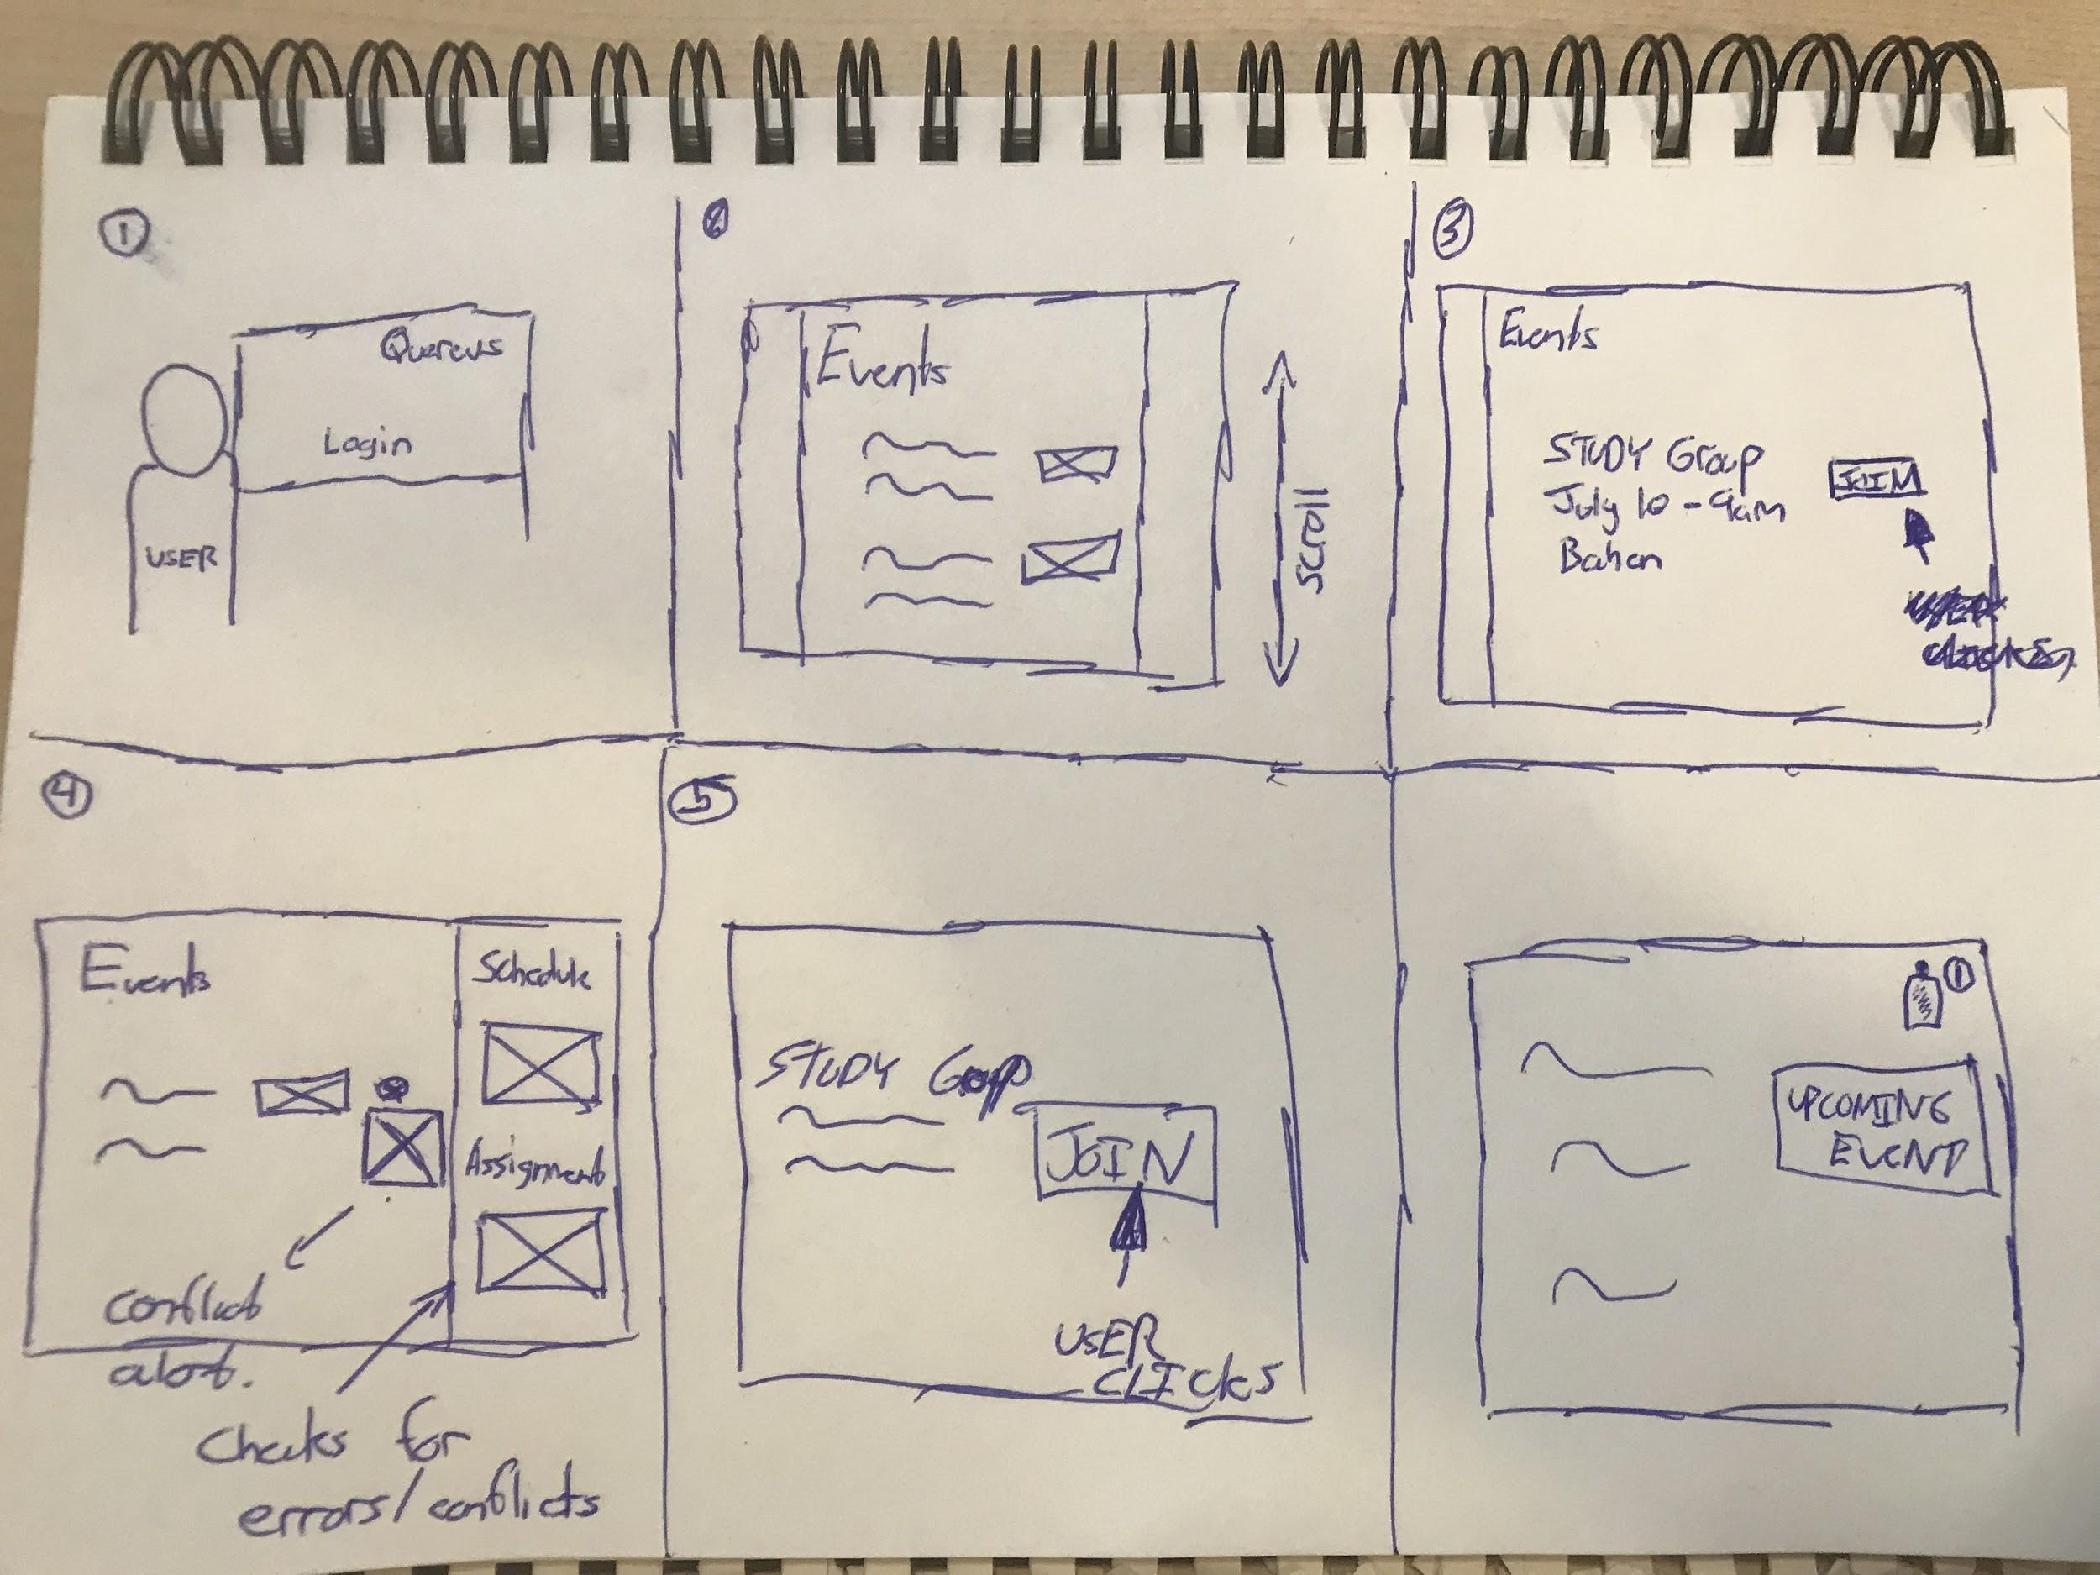
Storyboard
User goes on our website/app
User looks for events
User finds interested event
User checks conflicts in schedule
User joins event
User gets notification on event day/time

Slide 16
Any Questions?

